Slide 1
Membership Plan and Goals

Slide 2
2023 Membership Target Dates
EARLY BIRD/NEF KICKOFF SEPTEMBER 13, 2023 50% Success
FALL MEETINGS OCTOBER 18, 2023 55% Success
VETERANS DAY NOVEMBER 15, 2023 65%
PEARL HARBOR DAY DECEMBER 13, 2023 75%
MID-WINTER JANUARY 18, 2023 80%
PRESIDENT’S DAY FEBRUARY 14, 2024 85%
LEGION BIRTHDAY MARCH 13, 2024 90%
CHILREN & YOUTH APRIL 10, 2024 95%
ARMED FORCES DAY MAY 15, 2024 100%
**DELEGATE STRENGTH 30 DAYS PRIOR TO
NATIONAL CONVENTION

Slide 3
2023-2024 RENEAL SCHEDULE
CUTOFF DATES RENEWAL MAIL DATES
MAY 15, 2023 JULY 1-8, 2-23
SEPTEMBER 13, 2023 OCTOBER 7-14, 2023
OCTOBER 18, 2023 NOVEMBER 10-18, 2023
DECEMBER 13, 2023 JANUARY 6-12, 2024
FEBRUARY 14, 2024 MARCH 2-8, 2024
APRIL 10, 2024 MAY 4-10, 2024
Transmittals not received by the cutoff date may prevent a subsequent renewal notice from being delivered at or around the renewal date.
Notes:
Because of the Department of Colorado is currently under suspension renewals that come into Department Headquarters at logged and priority mail to scanner operations in Indianapolis, ID for processing.
Dues that come into headquarters is deposited into the General Checking account. NO MONEY is drawn from this account. All membership submitted to department and national headquarters is processed (unfunded) meaning that national is marking those members paid and will issue an invoice to the Department at the end of suspension for payment back to national.

Slide 4
2024
Membership Award Program
The following district will be sister districts.
Districts 1 and 2
Districts 3 and 4
Districts 5 and 6
Districts 7 and 8
Districts 9 & 10
District 11 and 12
District 13 and 14
District 15
(Department HQ Posts 211 & 123)
A total of 7 sister district awards will be given out after each target date.
The sister district who meets the target and has the highest percentage will win the award.
Posts who meet or exceed the membership percentages by the target date will receive an award are each target date.
Notes:
Awards will be given out at Mid-Year Conference and Department Convention

Slide 5
District Map
Notes:
Awards will be given out at Mid-Year Conference and Department Convention

Slide 6
Membership Goals 2024
District | New | PUFL | Renewal | HQ Tran | Totals | Goal
CO Dist 0001 LGN | 0 | 23 | 0 | 0 | 23 | 348
CO Dist 0002 LGN | 0 | 27 | 0 | 0 | 27 | 224
CO Dist 0003 LGN | 0 | 49 | 0 | 0 | 49 | 386
CO Dist 0004 LGN | 0 | 376 | 0 | 1 | 377 | 2839
CO Dist 0005 LGN | 0 | 378 | 0 | 0 | 378 | 2882
CO Dist 0006 LGN | 0 | 375 | 0 | 0 | 375 | 2458
CO Dist 0007 LGN | 0 | 509 | 0 | 0 | 509 | 2590
CO Dist 0008 LGN | 0 | 91 | 3 | 0 | 94 | 892
CO Dist 0009 LGN | 0 | 40 | 0 | 0 | 40 | 210
CO Dist 0010 LGN | 0 | 45 | 0 | 0 | 45 | 373
CO Dist 0011 LGN | 0 | 63 | 0 | 0 | 63 | 399
CO Dist 0012 LGN | 0 | 44 | 0 | 1 | 45 | 241
CO Dist 0013 LGN | 0 | 48 | 0 | 0 | 48 | 349
CO Dist 0014 LGN | 0 | 53 | 0 | 0 | 53 | 293
CO Dist 0099 LGN | 0 | 288 | 0 | 0 | 288 | 2195
SUM: | 0 | 2409 | 3 | 2 | 2414 | 16679

Slide 7
National Dues Increase effective 2025 Membership Year This increase will appear on the July renewal notices
YEAR | DISTRICT DUES | DEPARTMENT DUES | NATIONAL DUES | TOTAL OUT FROM POST
2024 | .50 | $17.00 | $18.50 | $36.00
2025 | .50 | $17.00 | 23.50 | $41.00
Posts with dues less than $41.00 should consider increasing their dues for 2025

Slide 8
Member Data Form
Minimum Required for submittal

Slide 9
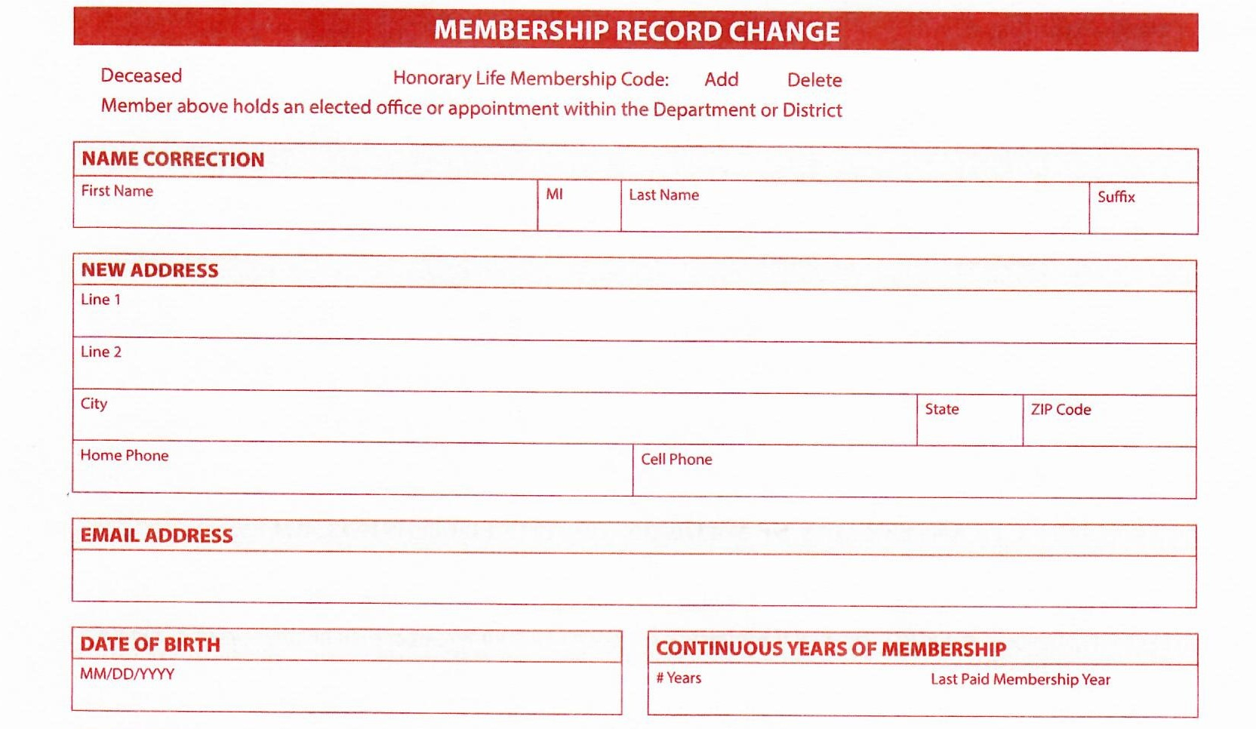
Member Data Form
This section is used to change members information
Notes:
This area is for changing members information

Slide 10
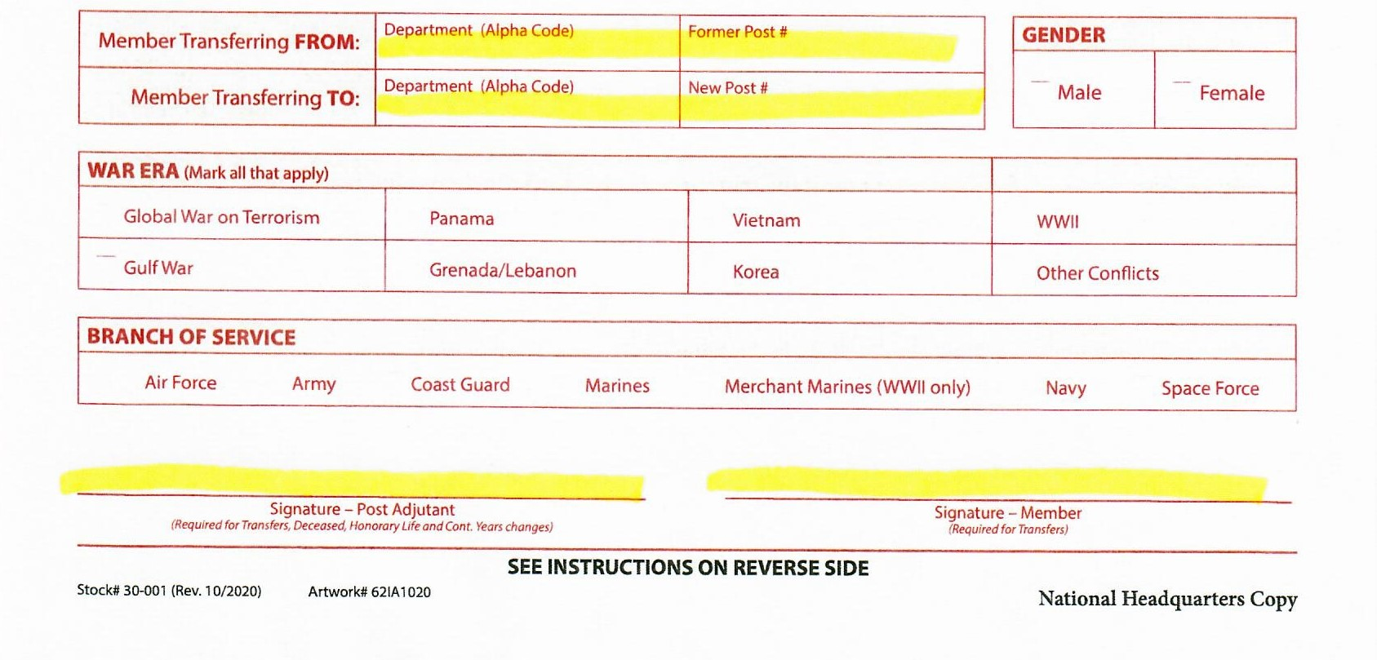
Member Data Form
Minimum Required for submittal
Member MUST Sign Or attach email authorization from the member
Post officer must sign
OUT OF STATE TRANSFER MUST GO TO NATIONAL HQ

Slide 11
Member Data Form
Minimum Required for submittal
MEMBER DATA FORMS ARE
NOT
USED FOR NEW MEMBERS

Slide 12
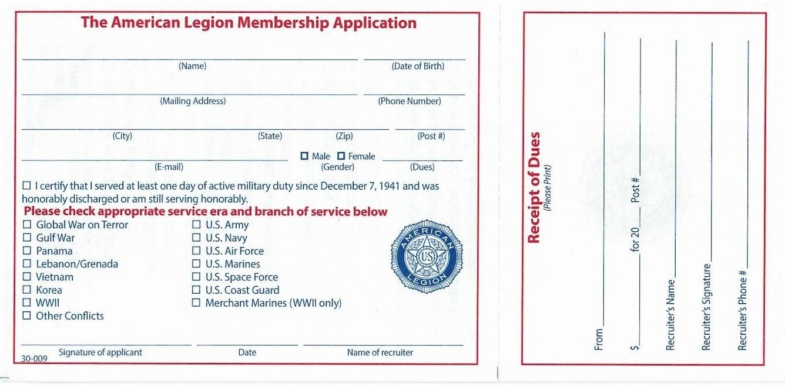
Membership Application
Complete left side and send to Department Headquarters
Keep the right side for post records

Slide 13
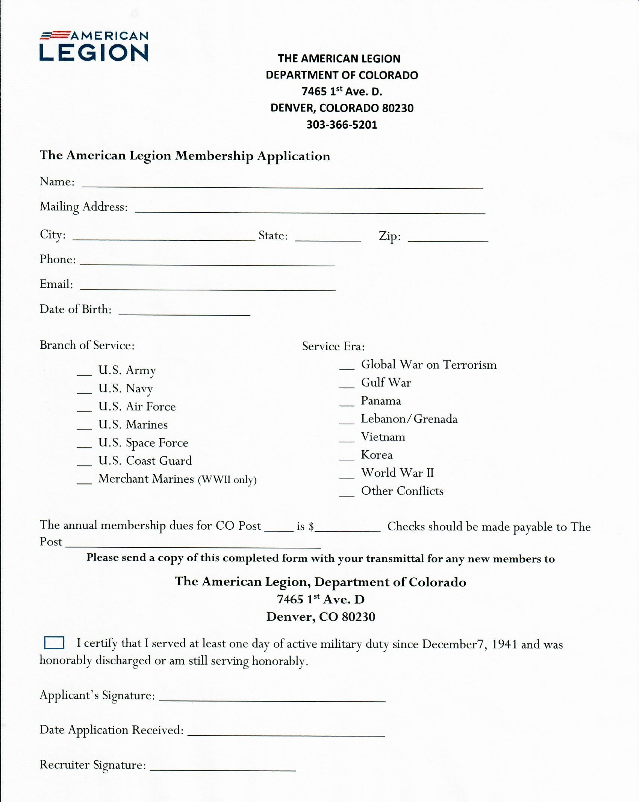
Minimum Required for submittal

Slide 14
Membership Card
This Number will be issued by National
Leave blank
You must include this with your check and transmittal form
All highlighted areas must be completed before submission
** Except email if member doesn’t not wish to

Slide 15
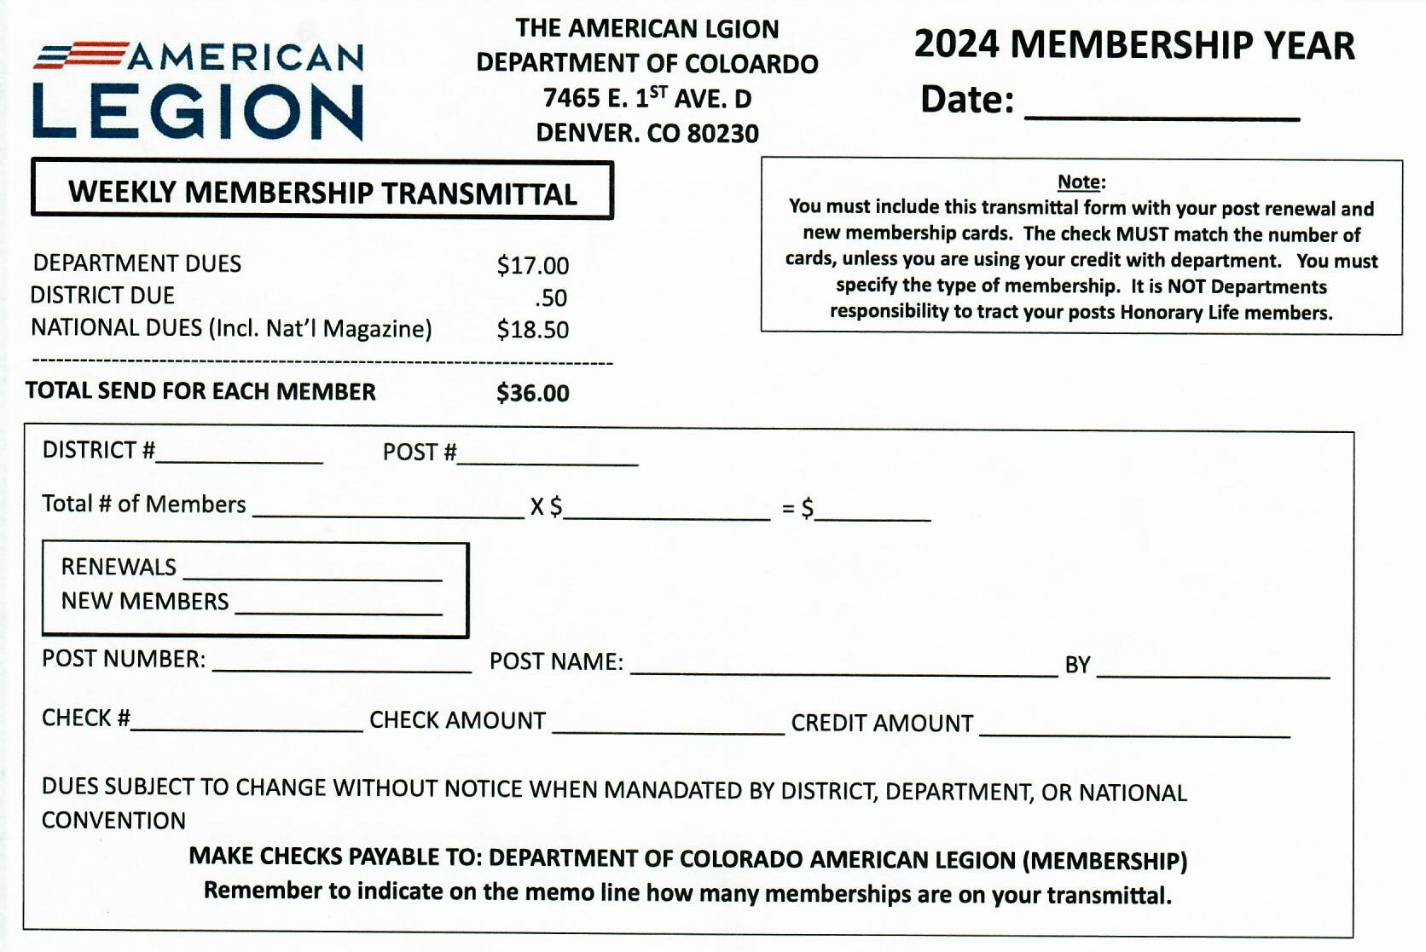
Membership Transmittal Form 2024
You must include this with your check and transmittal form

Slide 16
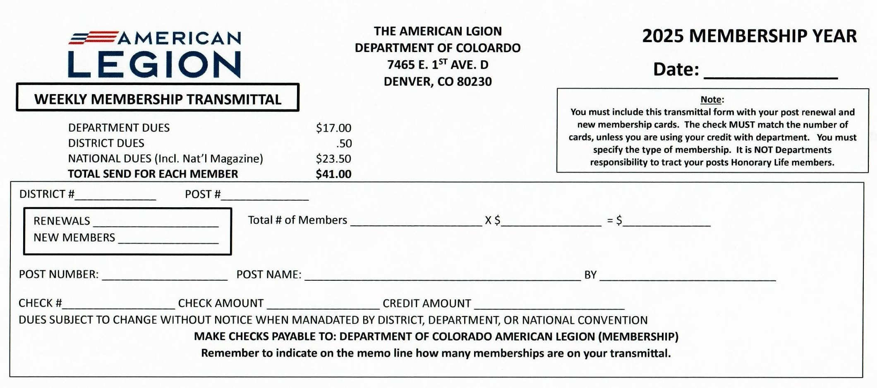
Membership Transmittal Form 2025
You must include this with your check and transmittal form

Slide 17
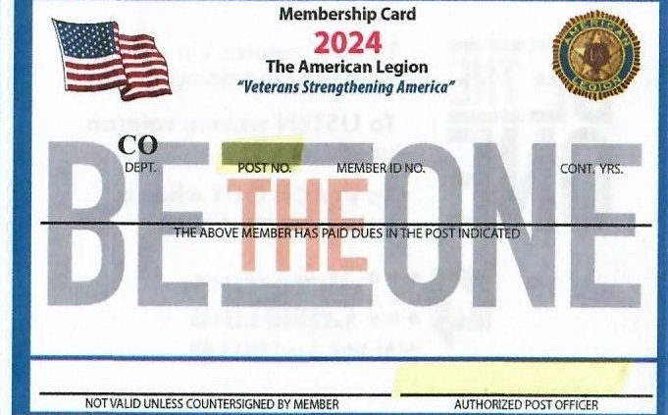
Member Data Form
This Number will be issued by National
Leave blank
Minimum Required for submittal
Post Officers needs to sign the card for it to be valid

Slide 18
QUESTIONS?
Department of Colorado Headquarters
7645 E. 1st Ave.
Denver, CO 8023
303-366-5202
OPEN
Monday – Friday
8:00 a.m. – 4:00 p.m.

